Slide 1



AI by Lavika Goel
Chapter 4 –
Knowledge representation

Slide 2
4.1 Introduction
Knowledge representation is a field that studies:
Representation of knowledge and facts about the world
Reasoning that can be performed using the aforementioned knowledge
In order to efficiently represent knowledge, one has to aim for the following goals:
Incorporate adequate knowledge of the problem and provide accurate solution
Be amenable to efficient computation while being maintainable, compact and natural
Be expressive enough to incorporate exploitable features of the problem to achieve computational gain
Efficiently trade off computational complexity and accuracy

Slide 3
4.2 Ontologies, objects and events
Ontological Engineering the process of representing abstract concepts such as creating representations of physical objects and events
The components of ontologies are
Objects
Categories
Attributes
Relations
Function terms
Restrictions
Rules
Axioms
Events

Slide 4
4.2 ontologies, objects and events
To formulate general purpose ontology that helps agents learn objects from virtually any field known in existence, one has to consider these two characteristics:
Ontology must be both flexible and extensible.
There must be unification of different areas of knowledge.

Slide 5
4.2.1 Categories and objects
Categories are collection of similar objects.
Categories can be used to make predictions about objects belonging to the same category.
Categories can be further classified into subcategories and allow rules to be specific
Boolean operation can be used to enhance reasoning skills of an agent to resolve conflict
‘subclass of’ and ‘member of’ are two very important operations performed in ontology
‘Disjoint’ and ‘exhaustive decomposition’ are some of the useful operations

Slide 6
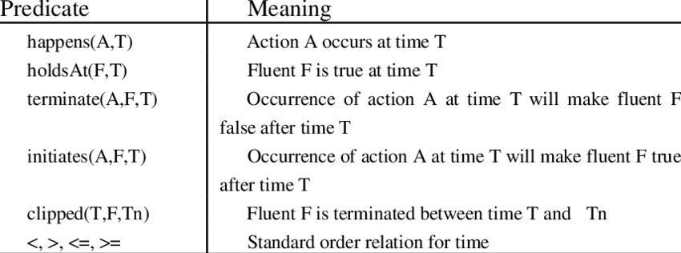
4.2.2 Events
Source: ResearchGate

Slide 7
4.3 Representations and mappings
Distinct type of entities that are commonly used in ontological expressions:
Facts
Representations of facts in some definitive formation
These entities are further divided into two levels:
Knowledge level
Symbol level

Slide 8
4.3 Representations and mappings
For an agent to arrive at desired reasoning, the agent has to do the following:
Translate initial facts into an internal representation
Use its inference engine to create the final facts while operating on the problem
Use natural language generation to generate the final facts desired
Following are some important properties of mapping:
Query answerability
Mapping inference
Mapping composition

Slide 9
4.4 approaches to knowledge representation
To represent the knowledge of a specific domain, following properties need to be satisfied:
Representational adequacy
Inferential adequacy
Inferential efficiency
Acquisitional efficiency
Relational knowledge (database representation) has a limited applicability in the field of knowledge representation in information systems.

Slide 10
4.4.2 Inheritable knowledge
Through property inheritance, we can add the ability of inference to relational knowledge.
Values are inherited by the elements from the class to which it belongs
Organization of the data is a hierarchy of classes
In AI algorithms, semantic nets are used to provide graphical aids for representing a categorical knowledge base. Some of these are:
Definitional networks
Assertion networks
Implication networks
Executable networks
Learning networks
Hybrid networks

Slide 11
4.4.3 Inferential knowledge
Description logics are designed for easier description of properties and definitions of categories. Some of the goals of description logics are:
Subsumption
Classification
Consistency

Slide 12
4.5 Forward vs backward reasoning
Attribute | Forward Reasoning | Backward Reasoning
Also known as | Data driven approach | Goal driven approach
Starting point | New data that defines the problem statement | Conclusion required to be reached
Aims for | Conclusion required by the problem statement | Initial data provided in order to solve the problem
Approach | Bottom up | Top down
Type of search | Breadth first | Depth first
Processing power | High | Low
Application | Design expert system | Diagnostic expert system

Slide 13
4.6 Matching and control knowledge
There is a need to develop a way for an artificially intelligent agent to be able to make the distinction to select the rules in order to either go forward or backward.
Out of the multiple ways to select the rules, few proposed solutions are discussed below:
Indexing: For each possible state, we use the state index to look up rules that are applicable and select the matching ones.
Matching with variables: Rete algorithm uses pattern recognition and some heuristics to be more efficient while calculating the rules to select.

Slide 14
4.6.2 Control
Control knowledge is a guide that is used to select the inference paths that need to be followed to reach a particular goal state. These are the four pillars of Control knowledge:
What are the rules that can be useful in the application?
What rules can be applied to a particular situation?
If subgoals are present, which order should be followed?
If there are multiple states to which an inference can lead, which states are preferable?

Slide 15
4.7 Slot and filler structures
Slot and filler structures can be divided into two distinct types:
Weak slot and filler structures: These contain only classes and categories of data with their linkages and are termed ‘knowledge-poor’
Strong slot and filler structures: In these structures, along with class and categories, data and content is also considered.

Slide 16
4.7.1 weak slot and filler structures
Semantic networks have formed the basis of definition of inheritance rules in carious modern programming languages.
Semantic networks are best used when data provided to an artificial agent is such that it can be organized into a taxonomic hierarchy.
Animal
Is a
Mammal
has
Pinna
Is a
GS
breed
Bruno
Coat color
Brown

Slide 17
4.7.1.1 partitioned semantic nets
PSN are used to represent propositions which might or might not be true.
Some complex sentences cannot be represented using simple semantic nets. For this PSN is used, which allows for the following
Without committing to the truth, one can make propositions.
Expressions can be quantified.
To represent statements as ‘Every wife is loved by her husband’ in PSN, a general node is used.

Slide 18
4.7.1.2 Frames
Frames are record like structures which consist of a collection of slots representing attributes and slot values.
Each frame should start and end with the parentheses.
A network of frames can be created by attaching two or more frames.
The following must be considered while constructing inference engine that works on frames:
Consistency checking
Propagation of definition values along isa and instance links
Default values are inherited
Slot value computation as needed
Verification of the calculation of correct number of values in the corresponding slots

Slide 19
4.7.2.1 Strong slot and filler structures – conceptual dependency
Conceptual dependency is based on the use of a limited number of primitive concepts and rules of formation to represent any natural language statement.
Roger C. Schank develop conceptual dependency structures.
Generally, five primitives can be used to describe conceptual dependency structures:
ACTs
Picture Producers (PPs)
Action Aiders
Picture Aiders
TS
While conceptual dependencies are helpful for representing and producing inferences on various events that occur relating to objects, they have no way of having events interact with each other.

Slide 20
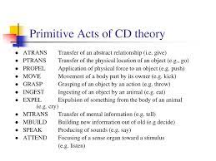
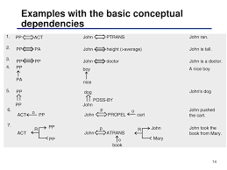
4.7.2.1 Conceptual dependency
Source: SlidePlayer
Source: SlideServe

Slide 21
4.7.2.2 scripts
Events in conceptual dependencies occur in isolation. Scripts help overcome this problem by providing specific mechanisms to link events.
Scripts are generally not used to represent all kinds of information.
A script has following various components:
Condition of an entry
Tracks
Result
Props
Roles
Scenes

Slide 22
4.7.2.2 scripts
A script is defined as a strong slot and filler structure that represents a pre-known sequence of events with regard to a particular context.
Scripts extend conceptual dependencies by including the following:
Patterns of linked events that are known to each other
Definitions of casual relationships between multiple events
Definition of an entry condition that sets the events in motion
Prerequisites that are required for each event to take place

Slide 23
4.8 issues in knowledge representation
Selection of important attributes
Identifying the relationship between attributes
Choice of granularity of representation
Representing categories of objects

Slide 24
4.9 developments in the field of knowledge representation – Resource description framework (RDF)
RDF is the most concise method among various formats for data interchange on internet.
RDF supports auto merging which leads to less data being consumed as only new information is sent and the old information is automatically merged by the RDF
The following are some of the reasons for the development of RDF:
Metadata on the internet
Application that require open data model
To process machine information
Interworking among applications
Automated processing of web information by software agents.

Slide 25
4.9.1 Resource description framework (RDF)
The design of RDF is intended to meet the following goals:
Have a simple data model
Have formal semantics and provable inference
Use an extensible URI based vocabulary with optional fragment identifiers
Use an XML based syntax
Support use of XML data types
Allow anyone to make statements about any resource

Slide 26
4.9.1 Resource description framework (RDF)
The underlying structure of any expression in RDF is a collection of triples, each consisting of a subject, predicate and object. RDF uses following key concepts:
Graph data model
URI – based vocabulary
Data types
Literals
Expression of simple facts
Entailment

Slide 27
4.9.2 web ontology language (OWL)
Semantic web language designed to represent rich and complex knowledge about things, group of things and relations between things
Ontologies written in OWL are generally published at various sources across the internet and are referred to as OWL ontologies.
Languages in the OWL family are capable of creating classes, properties, defining instances and its operations
The OWL abstract syntax presents an ontology as a sequence of annotations, axioms and facts.

